Slide 1

dynamic linking
Week 7
Google Slides Version
Image Source

Slide 2
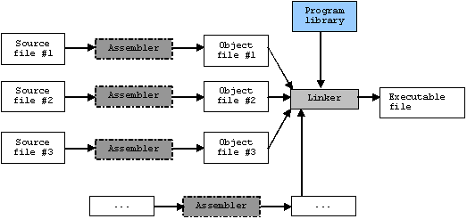
the linker

Slide 3
the linker
What does the linker actually do when turning object modules into an executable?
symbol resolution: associate each symbol reference with exactly one symbol definition
relocation: compilers and assemblers generate code and data that start at memory address 0; linker relocates these sections

Slide 4
object files
types:
relocatable: binary code and data in a form that can be combined with other relocatables to create an executable
executable: binary code and data that can be copied directly into memory and executed
shared object file: special type of relocatable that can be loaded into memory and linked dynamically at load time or run time

Slide 5
the linker +object files
So compilers and assemblers generate relocatables
Linkers take relocatables and generate executables

Slide 6
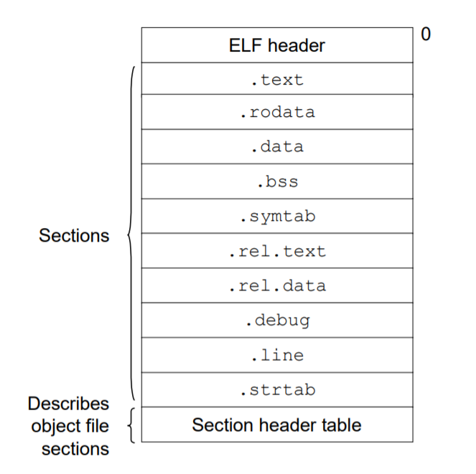
relocatable object file format
ELF (executable and linkable format)

Slide 7
linking with static libraries
In practice, compilation systems usually come bundled with a mechanism to package related object module into a single file - a static library
The linker can now:
take the static library as input
copy only the object modules in the library that our program references
create an executable using those copies of the library object modules

Slide 8
creating a static library
create some file lib_foo.c and a corresponding header lib_foo.h
compile, but do not link: gcc -c lib_foo.c -o lib_foo.o
use ar to create static library: ar rcs lib_foo.a lib_foo.o
note that a static library is a .a file - compiled, but not linked
note that static libraries usually follow the format lib<library name>.a
run a program main.c with static library:
gcc -c main.c -o main.o
gcc -static -o main main.o -L. -l_foo

Slide 9
pros & cons of static linking
If library code is updated, program has to be recompiled entirely
Every single program that uses a particular library now has their own copy of the library - inefficient use of memory
But, program will usually run faster - all your code has already been found and linked together

Slide 10
dynamic linking
What if we just had one, central copy of a library object module, and we simply referenced it as needed during runtime?
shared library: collection of functions compiled and stored in an executable to be linked at run-time
When compiling our program, the linker stores references to where to find the needed object modules. On startup, the program then loads the needed shared library into memory.
There is now one shared copy of our library, in a .so file.

Slide 11
creating a dynamic library
Use gcc with the -fPIC and -shared flags now
Tell your environment where your path to your shared library is:
export LD_LIBRARY_PATH=.:$LD_LIBRARY_PATH
Useful commands to check libraries: nm <.so file> to see functions in a library, ldd <.so file> to see dependencies

Slide 12
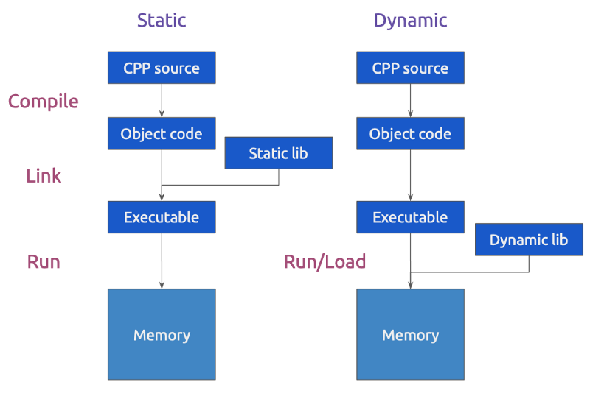

Slide 13
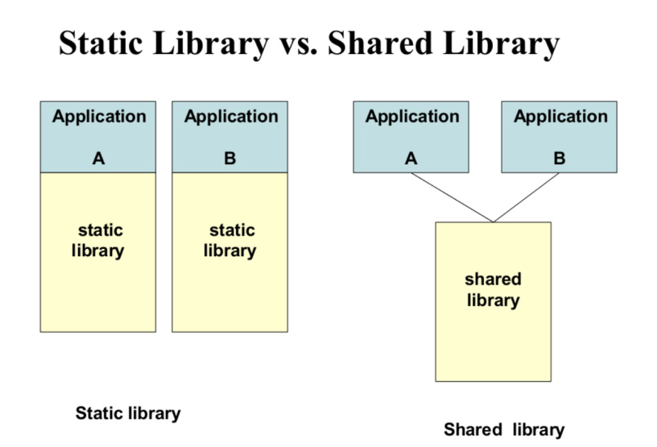

Slide 14
pros & cons of dynamic linking
Takes up less memory! Every executable does not contain it’s own copy of the library; instead, multiple files can access .so at run time.
You don’t need to recompile every copy of the library every time some code changes - just the one reference needs to be recompiled
Linking is performed on the fly, which means extra steps during run time - so this method is slower

Slide 15
dlopen
void * dlopen(const char *filename, int flag)
open a library and prepare it for use
filename is either absolute path to directory, or searched for in LD_LIBRARY_PATH list
use a dl_handle to call it:
void * dl_handle = dlopen(“some_dl.so”, RTLD_LAZY);
if (!dl_handle){
//some error happened in calling dl_open
}

Slide 16
dlopen
Value of flag can be:
RTLD_LAZY: resolve undefined symbols as code from the dynamic library as needed
RTLD_NOW: resolve all undefined symbols before dlopen() returns and fail if this cannot be done

Slide 17
dlsym
void * dlsym (void *handle, char *symbol)
Actually using the library you opened with dlopen (remember dl_handle?)
symbol is a string representation of what function you want to find in the library
You’ll get a return value of the resolved memory address of where the symbol you requested can be found
Return NULL if symbol can’t be found

Slide 18
dlsym
void * my_func (int *);
my_func = dl_sym(dl_handle, “double_int”);
int i = 10;
my_func(&i);

Slide 19
dlclose
char *dlclose(void * handle)
closes whatever dlopen() opened
dl libraries actually manage link counts for dynamic file handles, so a library can be called multiple times by multiple different programs - it won’t remove that library from memory until dlclose has been called as many times as dlopen has been called
dlclose(dl_handle)

Slide 20
dlerror
char *dlerror()
Returns a string describing error from last call to dlopen(), dlsym(), or dlclose()
Returns NULL if no error was encountered since last dlerror() call
char * error = dlerror();
if (error != NULL){
printf(“%s\n”, error);
}

Slide 21
using dl functions
Use #include <dlfcn.h>
Basic compile: gcc -o myfile myfile.c -ldl

Slide 22
attributes
void some_func () __attribute__((flag));
‘attribute’ keyword allows you to declare certain things about your function that the compiler can recognize and use to optimize performance
sample flags: noreturn, const, deprecated, constructor, destructor
constructor attribute will run with dlopen, destructor will run with dlclose

Slide 23
dynamic linking vs dynamic loading
dynamic loading: mapping/copying an executable or library into a process’s memory after process has already started
dynamic linking: resolving symbols (getting names, addresses, etc.) after compile time.
Here is a good link that dives deeper into what this means.

